Slide 1
Multiple instance learning with pre-contextual knowledge
Università degli studi di Modena e Reggio Emilia
Corso di AI Engineering
Grandi Andrea (275074)
Vellani Daniele (196186)

Slide 2
Aim of the project
Modify a MIL architecture and see if adding contextual knowledge to it will give better results
The additional info is given by a segmentation and analysis tool called CellPose, working directly on the WSIs

Slide 3
Scientific/Practical Importance

Slide 4
Project workflow
Preprocessing
Segmentation
Feature extraction
BUFFERMIL
Preprocessing: created the various patch using CLAM
Segmentation: CellPose results aren't enough for the architecture chosen
Feature extraction: DINO model
Integration with pre-existing BUFFERMIL architecture: find a way to use feature extracted

Slide 5
Preprocessing with CLAM

Slide 6
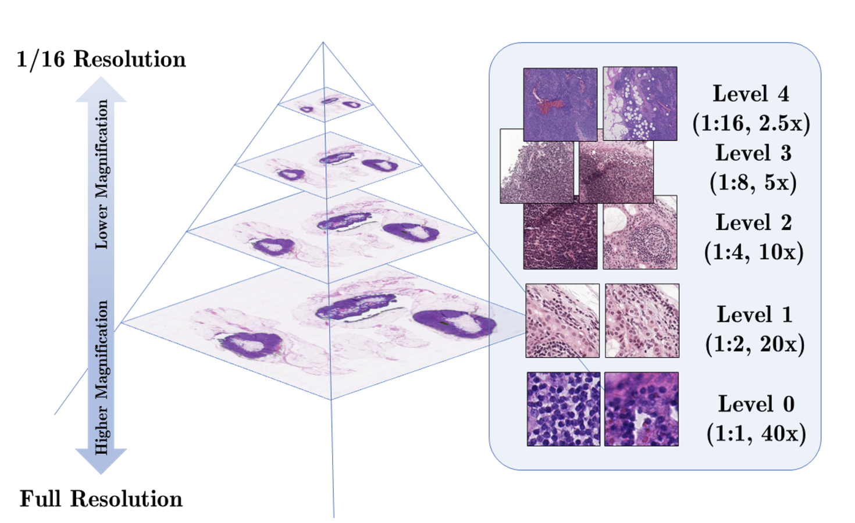
What is a WSI?
Definition: Scanning a complete microscope slide to create a single high-resolution digital file.
Process: Capturing many small high-resolution image tiles and montaging them to create a full image.
Impact: Transforming laboratory workflows by enabling efficient storage, access, analysis, and sharing of digital slides.

Slide 7
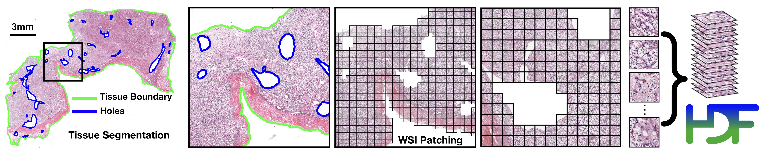
CLAM
Capability: CLAM is a high-throughput and interpretable method for data efficient whole slide image (WSI) classification.
Advantage: CLAM can handle multi-class subtyping problems and adapt to independent test cohorts of WSI resections and biopsies as well as smartphone microscopy images.
Feature: CLAM does not require any ROI extraction or patch-level annotations.

Slide 8
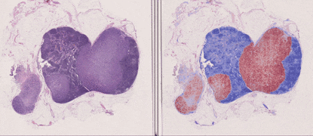
How does CLAM work?
Method Type: Deep-learning-based weakly-supervised method.
Purpose: Accurately classify whole slides by identifying sub-regions of high diagnostic value.
Key Technique: Attention-based learning and instance-level clustering.

Slide 9
How we integrated CLAM in our work
CLAM Integration: Integrated CLAM for image preprocessing, specifically extracting patches from TIF or SVS files.
CLAM Output: Generates three directories (masks, patches, stitches) and a CSV file containing metadata and variables used for patch creation.
Patch Format: Patches are stored in H5 format and converted to JPG for usability.

Slide 10
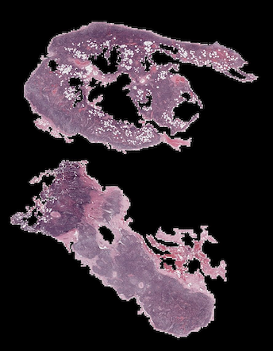
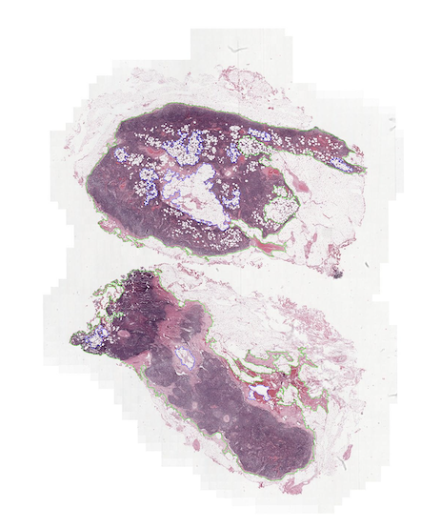
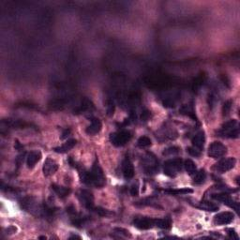
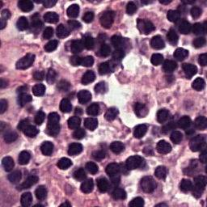
Some examples
Starting from the slide, CLAM generates the stitches, masks and patches

Slide 11
Segmentation using Cellpose

Slide 12
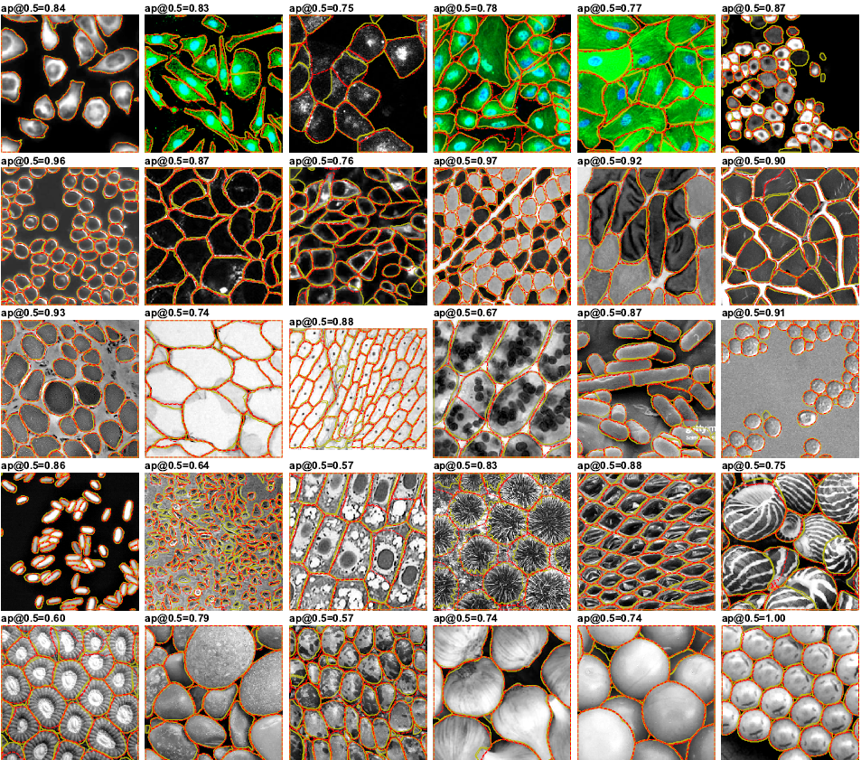
What is Cellpose?
Convenience: segmentation algorithm which performs on wide range of image types out-of-the-box
No need for tuning: doesn't need any retraining or parameter adjustments
Well trained: training done using a large dataset of cells images

Slide 13
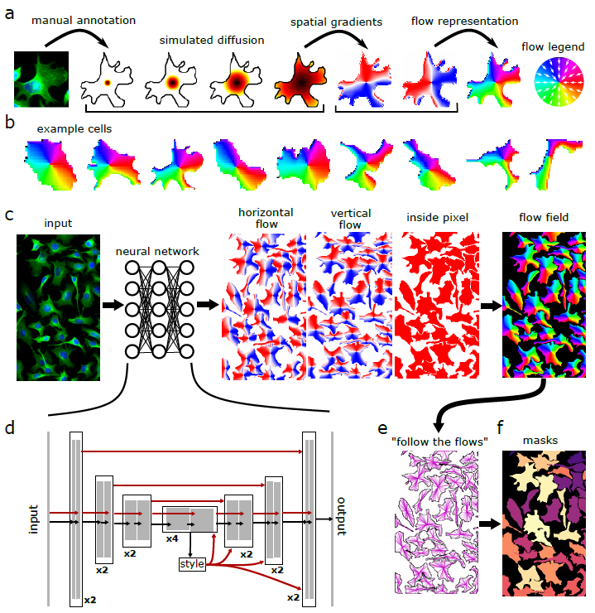
How does Cellpose work?
Method Type: Basic deep neural network design based on the general U-net architecture
Purpose: Doing segmentation on a wide range of images (not only for medical purposes)
Key Technique: Transforming images to be predicted directly by a neural network using a heat source and giving energy to every mask.

Slide 14
The importance of Cellpose
Why do we need a segmentation algorithm: the aim of the project is to add contextual features, similar to a human helping the BufferMIL
Results are not enough:

Slide 15
Results with Cellpose
Segmented images obtained on the dataset

